Slide 1
“Automatic Stock Notification”
AdHoc & Sensor Network
WiSe14
Group 3

Slide 2
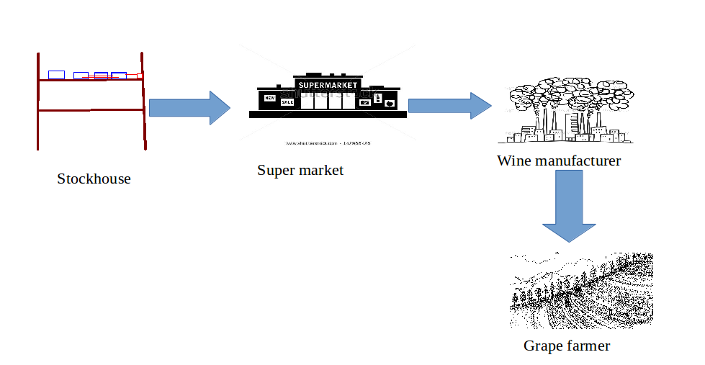

Slide 3
Basic Idea
proximity sensors are installed in every shelf of a warehouse
whenever products are taken out for delivery the sensor detects the change
on such changes, the information is forwarded to a nearby router
this stock change updates are stored in a central database
a user-interface (web front-end) allows to access real-time information about the current stock

Slide 4
Benefits
keeps track of current stock in shelf
may be extended so that this information can be accessed also by the manufacturer of a certain product of the supply-chain in order to control the production according to the live demand
this helps in preventing wastage due to overproduction and meet the market demand correctly. Furthermore it allows it to keep manufacturers wearhouse small
It is applicable for all product categories in food supply chain and might be also useful for other areas

Slide 5
The sensor
router
sensor
products are removed, change is detected
shelf with products

Slide 6
The infrastructure
stockkeepers, manufacturers
users
DB +
Web
storage of current stock values + front- end to access info
router to forward updates
Shelf 1
Shelf 2
Shelf 3
Shelf 4
nodes in every shelf, for every product
Product A
Product A
Product D
Product A
Product A
Product C
Product D
Product N

Slide 7
Hardware
Nodes + Sensor
proximity sensor, i.e. ultrasound (?)
alternative sensors suited for this project
RFID, NFC
color sensor, i.e. to detect the back side of a shelf
Router
depends on node
Other Components
DB/Webserver: running on a Notebook

